Slide 1
Shrinkage & Column Subsampling
袁满杰 2021.5.13

Slide 2
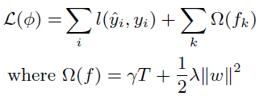
Background
To prevent overfitting in Forest Models:
Regularization:
Shrinkage
Column Subsampling

Slide 3

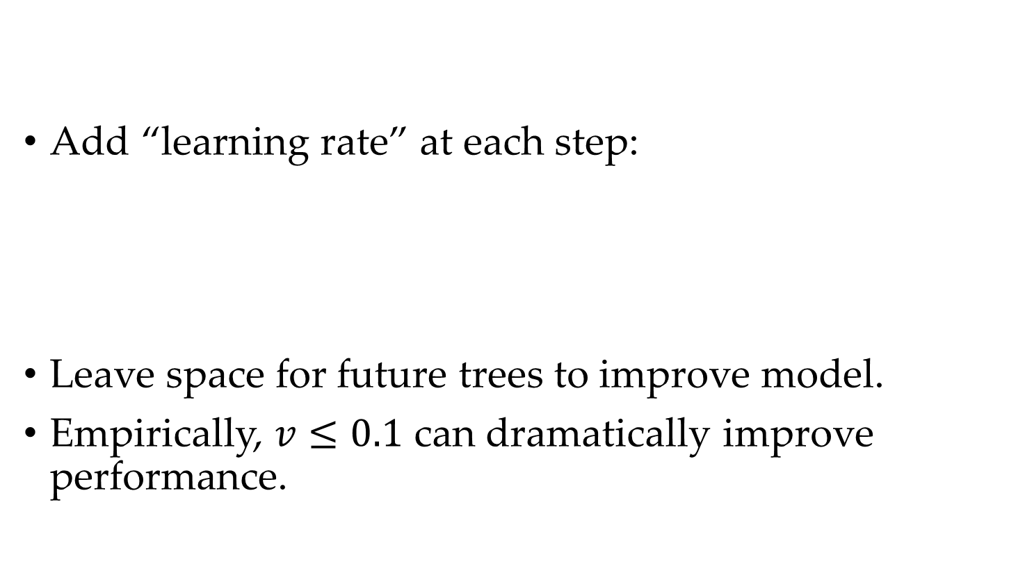
Shrinkage
Add “learning rate” at each step:
Leave space for future trees to improve model.
Empirically, $v≤0.1$ can dramatically improve performance.

Slide 4
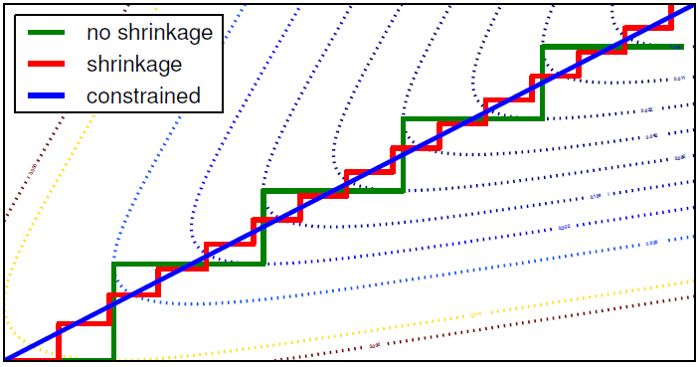
Shrinkage
Theoretically, shrinkage can lead to the maximum margin, which leads to better generalization.

Slide 5
Column Subsampling
Both column subsampling and row subsampling is supported.
Row/Column subsampling: Sample on instances/features
Empirically, column subsampling is better
Three types:
Sample by node
Sample by level
Sample by tree
Advantages:
Increase diversity → Better generalization
Can also reduce running time.

